Slide 1
OPEN INNOVATION
Leaf Sync - Smart
Monitoring System
A hidden IoT-based personal safety device disguised as a decorative plant

Slide 2
01
The Problem
Phones unreachable
The Core Gap
Hard to grab during a sudden threat
No existing system combines hidden activation, instant alerting, and audio evidence in a single discreet device.
Visible panic buttons
Easily spotted and disabled by attackers
No evidence collected
Who it affects
Traditional alerts don't record what happened
Women at home, hostels, PGs
Elderly individuals living alone
Complex activation
Multi-step apps fail when speed matters
Anyone in an indoor emergency

Slide 3
02
Our Solution
A smart safety system hidden inside an artificial flower pot
Discreet Design
Two-Step Activation
Instant Alert
Looks exactly like a decorative pot. No one suspects a thing.
Tap the pot → touch the secret leaf. Dual-trigger prevents false alarms.
Sends emergency notification to the Blynk app via Wi-Fi in seconds.
Audio Evidence
Dual Controllers
No App Needed to Trigger
INMP441 mic records surroundings. Saved to SD card for later use.
ESP32 handles recording. ESP8266 handles alerting. No bottleneck.
Simple physical gestures activate the system — even in panic.

Slide 4
03
How It Works
1
2
3
4
Tap the Pot
Touch the Leaf
Alert Sent
Audio Recorded
Vibration sensor detects knock — Step 1 activated
Hidden capacitive sensor confirms — Step 2 done
ESP8266 fires notification to Blynk app via Wi-Fi
ESP32 captures surroundings via I2S mic to SD card
ESP8266 → Alert & Notification
ESP32 → Audio Recording & SD Storage

Slide 5
04
Technology Stack
HARDWARE
SOFTWARE
ESP32 DevKit V1
Arduino IDE
Main controller — audio + SD
Embedded C for ESP32 & ESP8266
NodeMCU ESP8266
Blynk IoT Platform
Wi-Fi alerts via Blynk
Real-time mobile alert delivery
Vibration Sensor
I2S Protocol
Tap detection — Step 1 trigger
High-quality digital audio input
Capacitive Touch Sensor
SPI Protocol
Leaf touch — Step 2 trigger
SD card read/write interface
INMP441 Microphone
Wi-Fi (802.11)
I2S digital audio recording
Cloud communication layer
MicroSD Module (32GB)
Cirkit Designer
Evidence storage via SPI
Circuit design & simulation

Slide 6
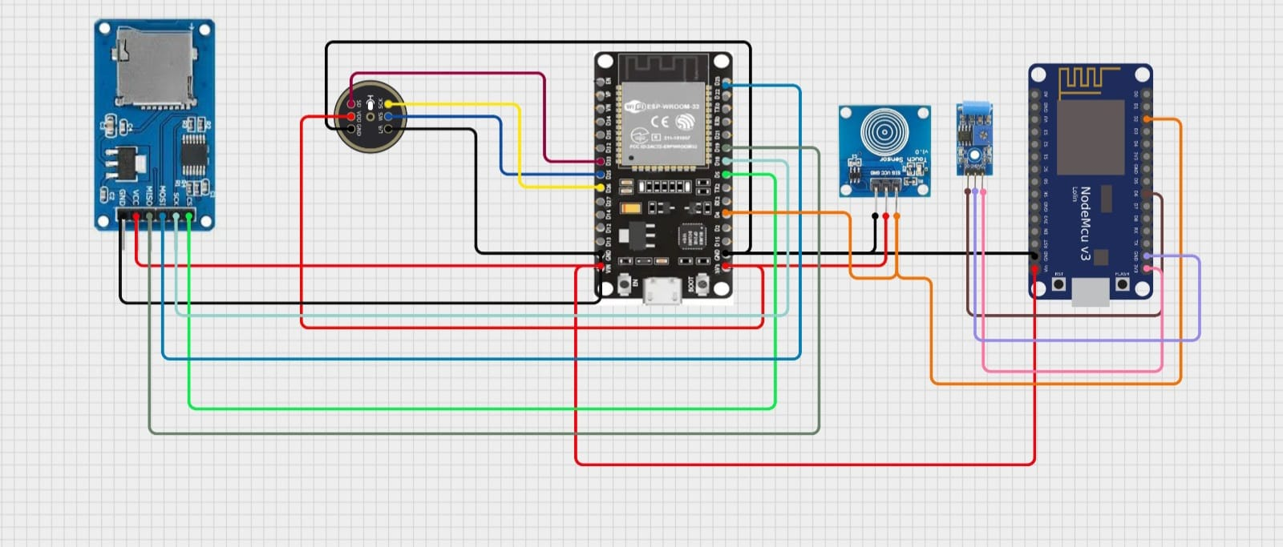
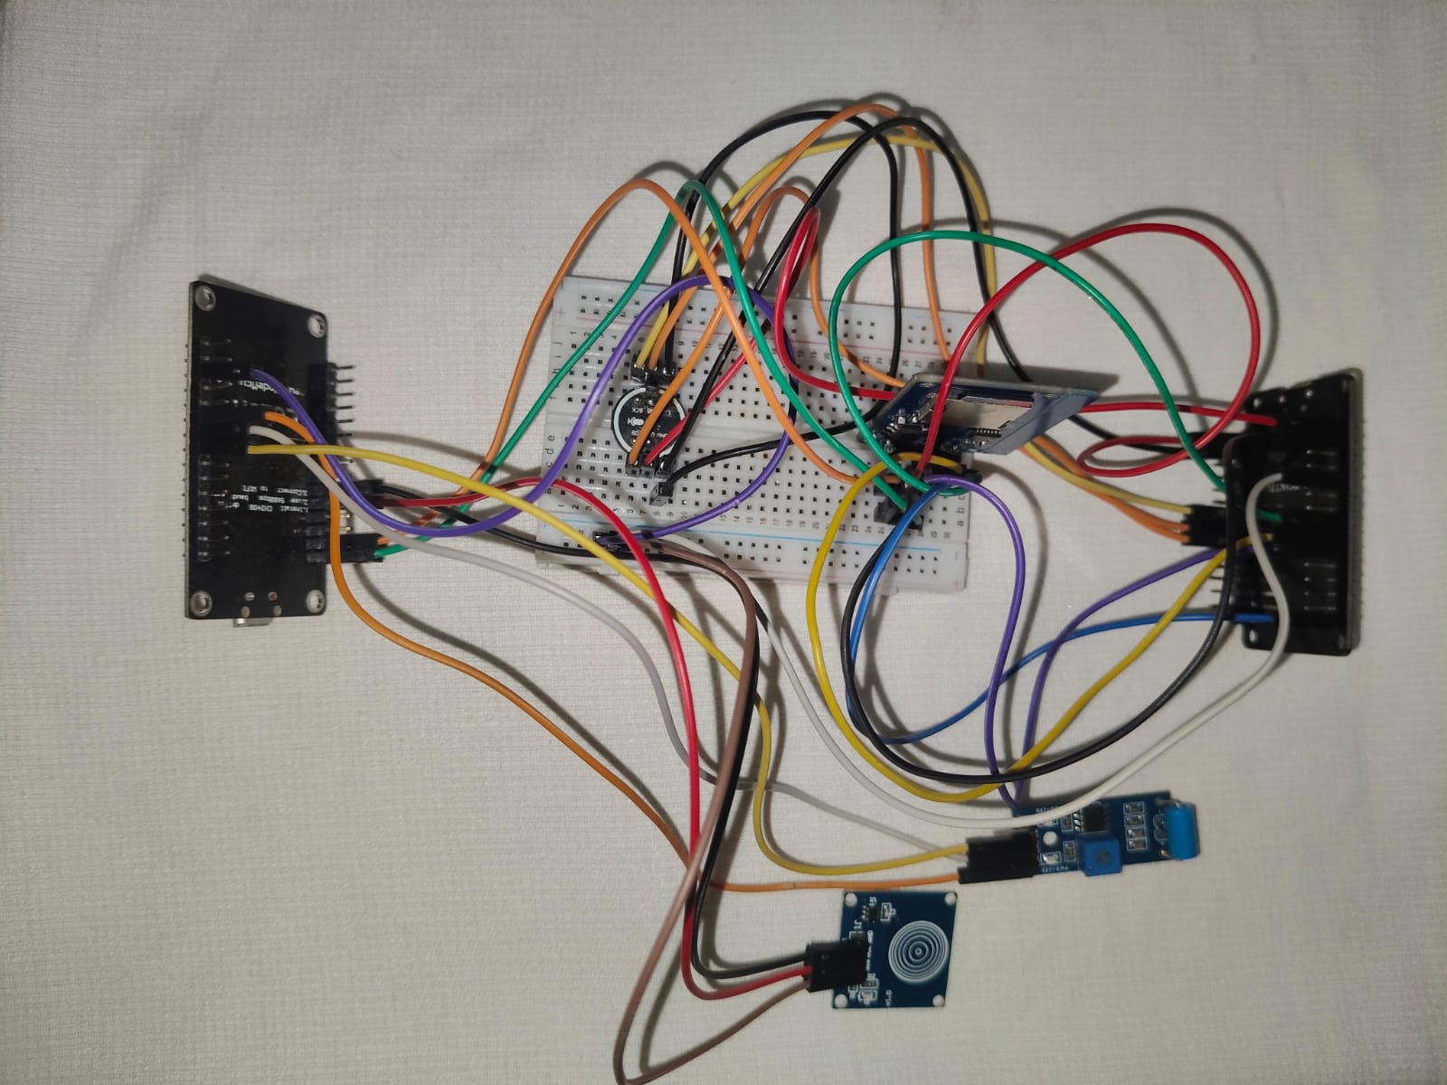
05
Project Implementation
ESP32 DevKit V1
Simulated setup
Prototype
NodeMCU ESP8266
Vibration Sensor
Capacitive Touch Sensor
INMP441 Microphone

Slide 7
06
Why This Stands Out
Feature Comparison
Feature
Panic Buttons
Safety Apps
Our System
Hidden / Discreet
✗
✗
✓
No phone needed
✓
✗
✓
Audio Evidence
✗
✗
✓
False-alarm prevention
✗
Limited
✓
Works offline (partial)
✓
✗
✓
Low cost
✗
✓
✓
Best for: Homes · Hostels · PG Accommodations · Elderly Care · Any Indoor Emergency

Slide 8
What's Next
GPS Integration
Cloud Audio Backup
Send live location with the alert for faster rescue
Upload recordings to cloud for remote retrieval
AI Distress Detection
Mobile App
Auto-trigger using sound pattern recognition
Custom dashboard for alert history and settings
Safety should be invisible — and always within reach.

